Slide 1



A Probabilistic Choreography Language for PRISM
Marco Carbone¹, Adele Veschetti²
¹IT University of Copenhagen
²TU Darmstadt
COORDINATION
18th June 2024

Slide 2


outline
1 Motivation
2 Choreographic Calculus
3 PRISM Language
4 Projection
5 Implementations
6 Conclusions

Slide 3
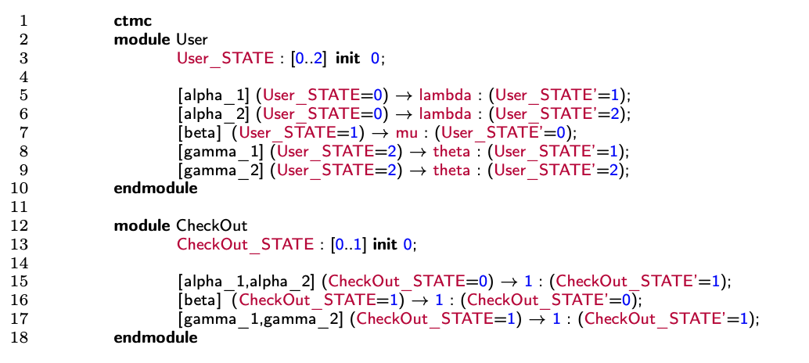
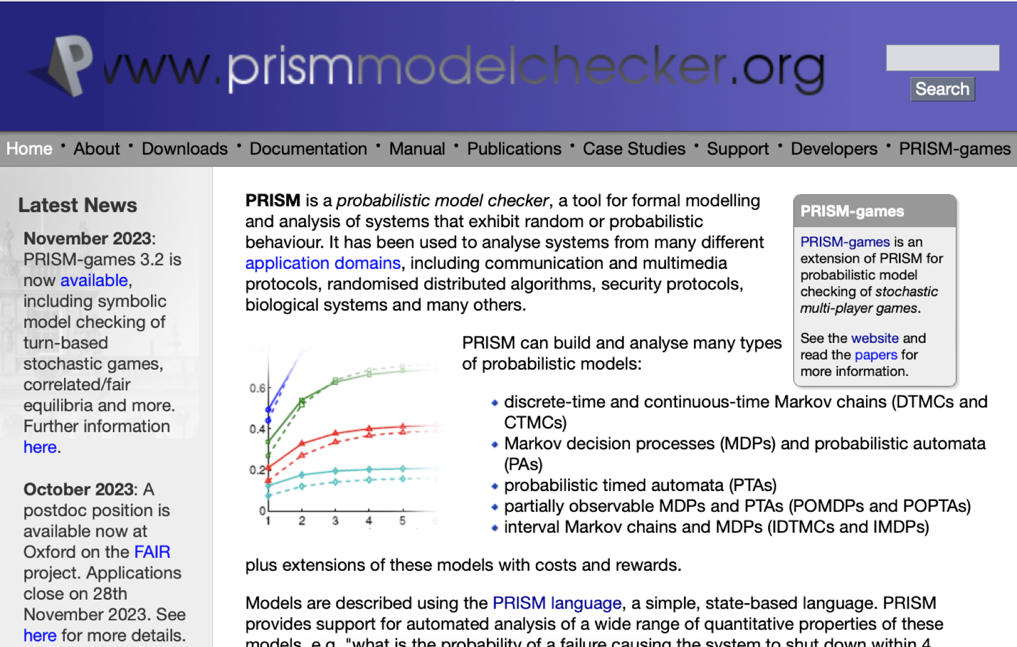

Prism¹
PRISM has a declarative approach
Very easy to add commands
Very hard to predict what their effect is on the system as a whole
PRISM language for modelling concurrent systems
Based on a declarative version of CSP (with probabilities/rates)
https://www.prismmodelchecker.org/
Conditions
Rates
Labels
High rrisk of modelling something else than what was intended
Updates
[1] Marta Kwiatkowska, Gethin Norman and David Parker. PRISM 4.0: Verification of Probabilistic Real-time Systems. In Proc. 23rd International Conference on Computer Aided Verification (CAV’11), volume 6806 of LNCS, pages 585-591, Springer, 2011

Slide 4
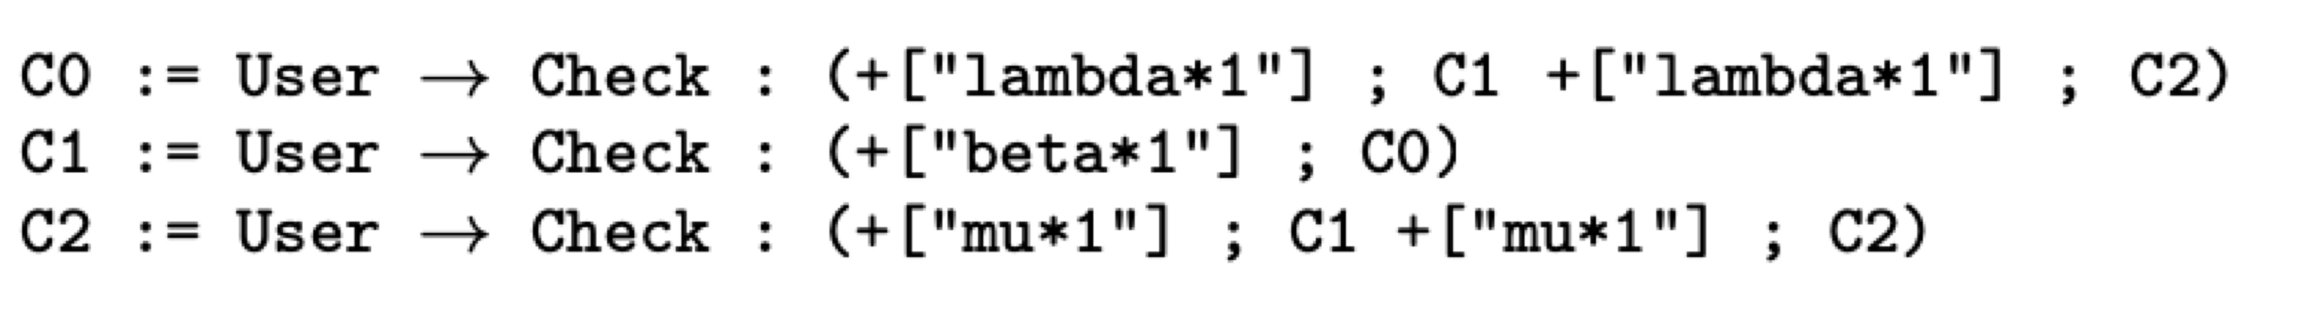
choreographies
Describe communication-based systems focusing on global flow of messages
Global viewpoint of an entire system
Entities have a common goal
No single point of control
Only focus on communications
3 Choreographies
Continuations
Deadlock-free programs
Processes Interactions
Choreographies

Slide 5


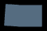
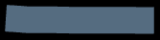

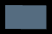
CHOREOGRAPHIC CALCULUS - syntax
Interaction initiated by module p with modules p_{i}s
λ_{j} denotes either a probability or a rate
Once a branch j is taken, the choreography will execute some assignments u_{j}
If-Then-Else: module p evaluates the guard E and then branches accordingly
(Possibly recursive) procedure call
End of the computation
Assignment: the value obtained by evaluating expression E is assigned to variable x
Update: assignments can be concatenated with the operator &

Slide 6
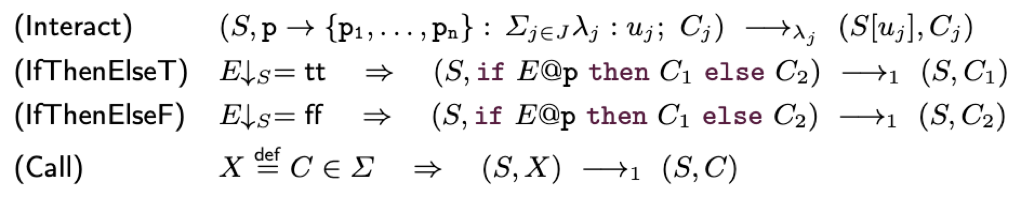
CHOREOGRAPHIC CALCULUS - semantics
The transition relation is a Discrete Time Markov Chain (DTMC) or a Continuous Time Markov Chain (CTMC) depending on whether we use probabilities or rates in the branching construct

Slide 7
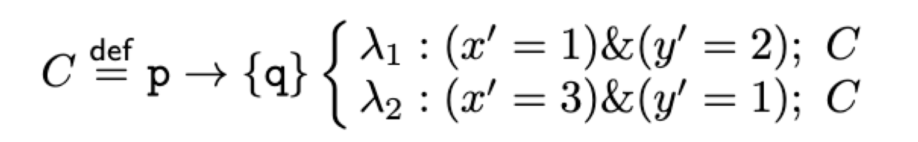
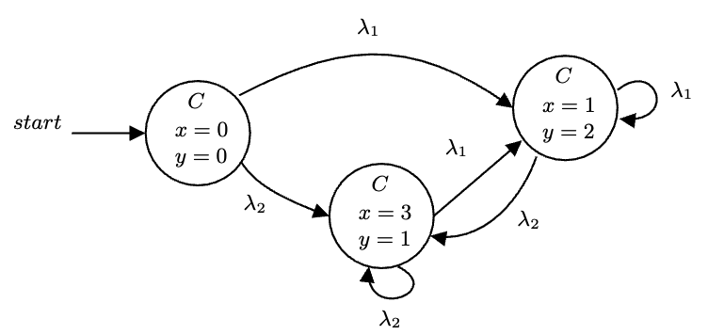
CHOREOGRAPHIC CALCULUS - example
Semantics of C from the state S(x) = S(y) = 0

Slide 8
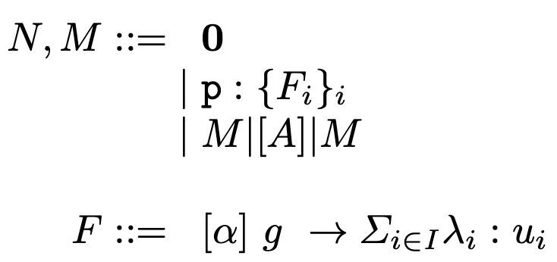



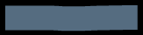

Prism - syntax
Networks
Empty Network
Module
Parallel Composition
Commands

Slide 9
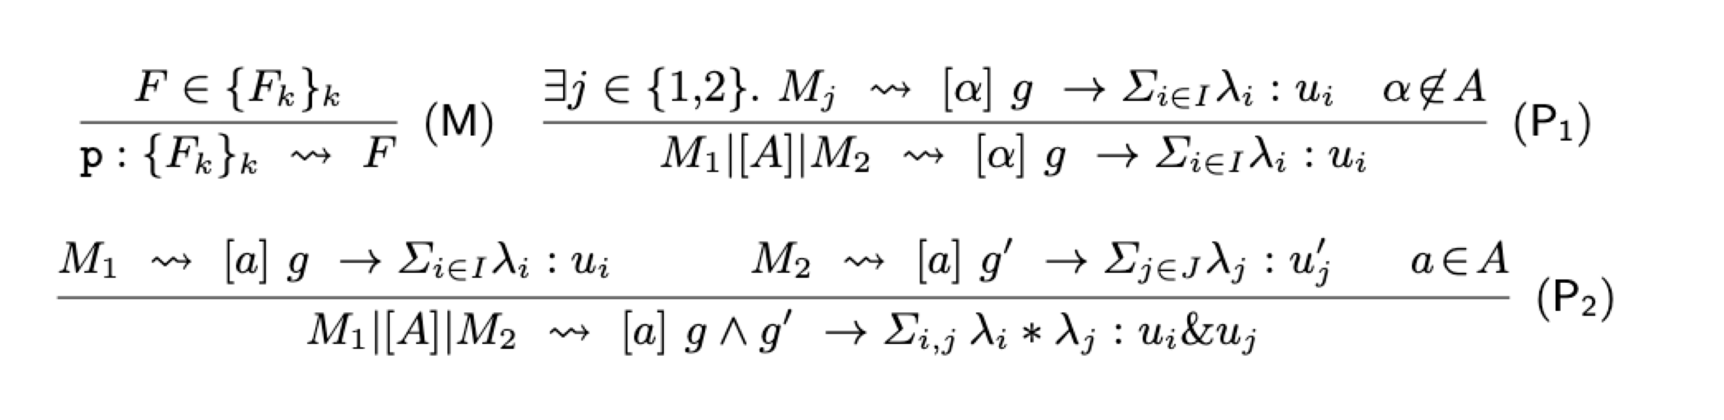
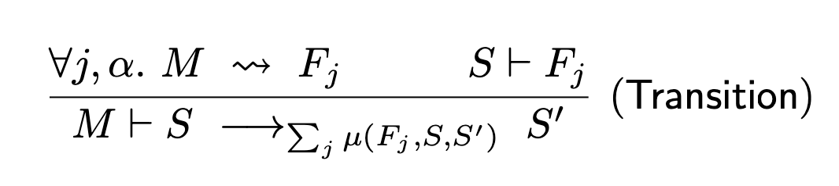



Prism - semantics
(M) exposes a command at network level
(P1) propagates a command through parallel composition if α is empty or a is not in A
(P2) the product of the probabilities/rates must be taken by extending the two different branches to every possible combination

Slide 10
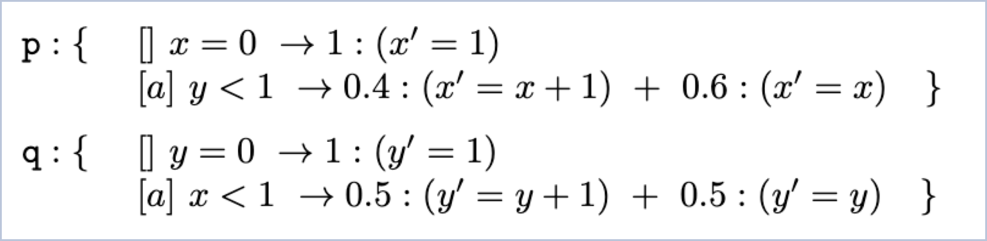
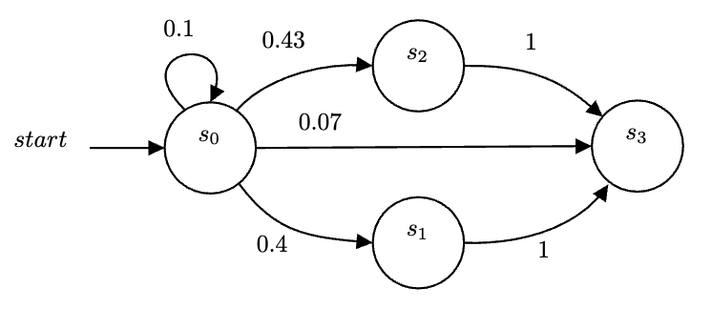
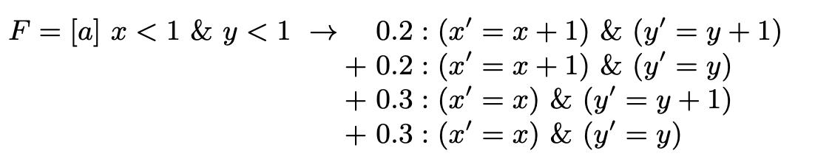
prism- example
Applying the semantics:

Slide 11
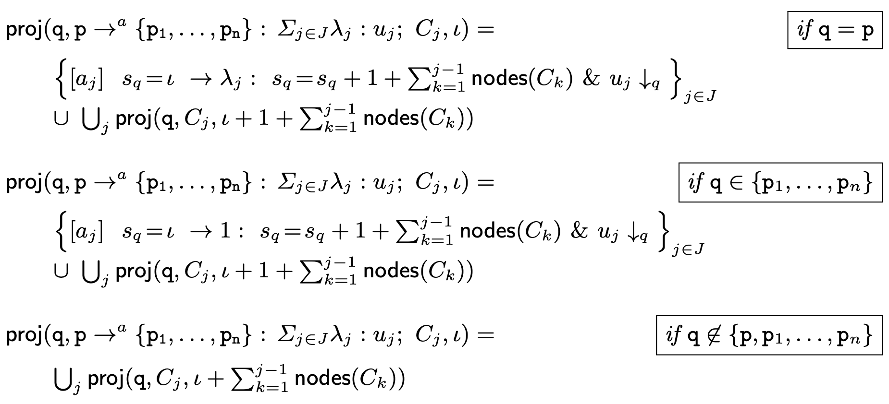
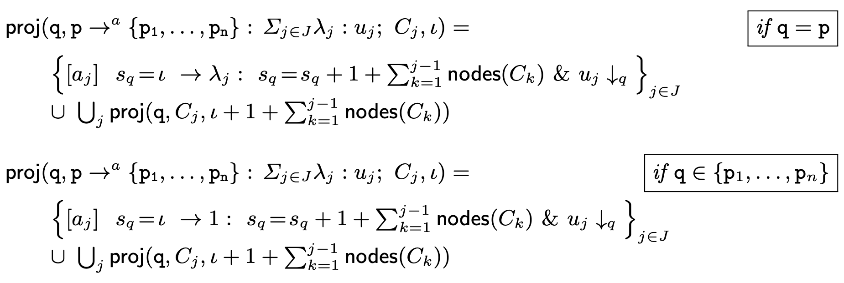
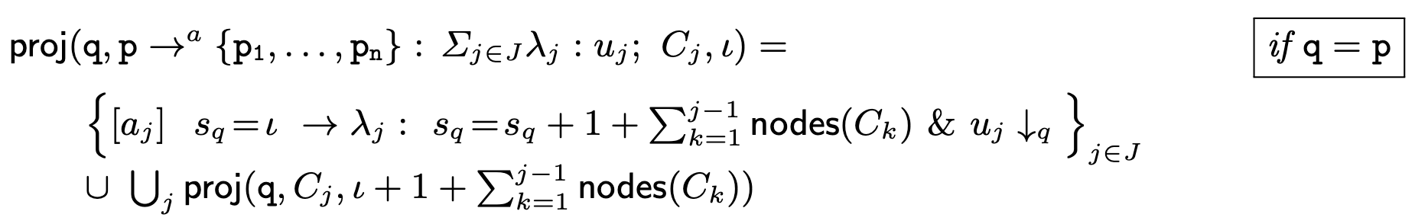

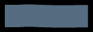
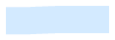
Projection: CTMC
Annotated choreographies
a label and an integer identify a node
s_{q} is the counter for this module
nodes(C) returns the number of nodes of C

Slide 12
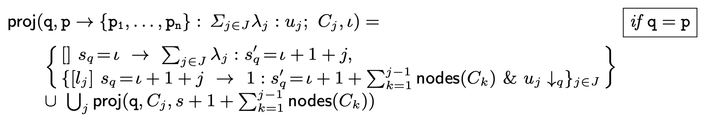
Projection: DTMC

Slide 13
Projection: correctness
Our projection operations are correct with respect to the semantics of choreographies and PRISM

Slide 14





IMPLEMENTATION
In Java, ANTLR
Available at https://github.com/adeleveschetti/ChoreoPRISM
Generates PRISM code that needs to be fed to PRISM
Implementation offers extra language constructs
Parametric modules renaming

Slide 15
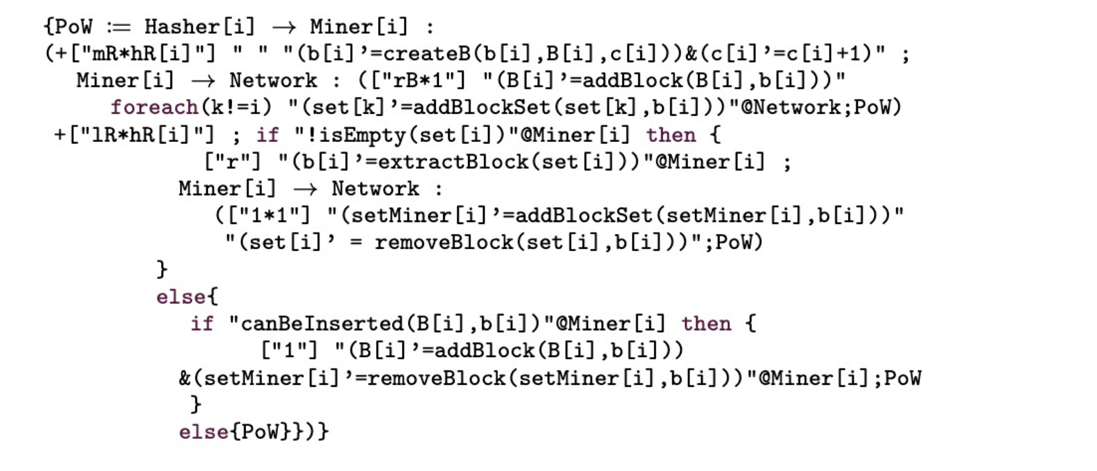
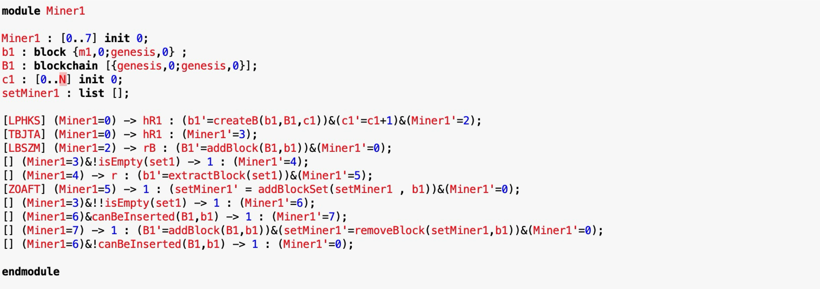
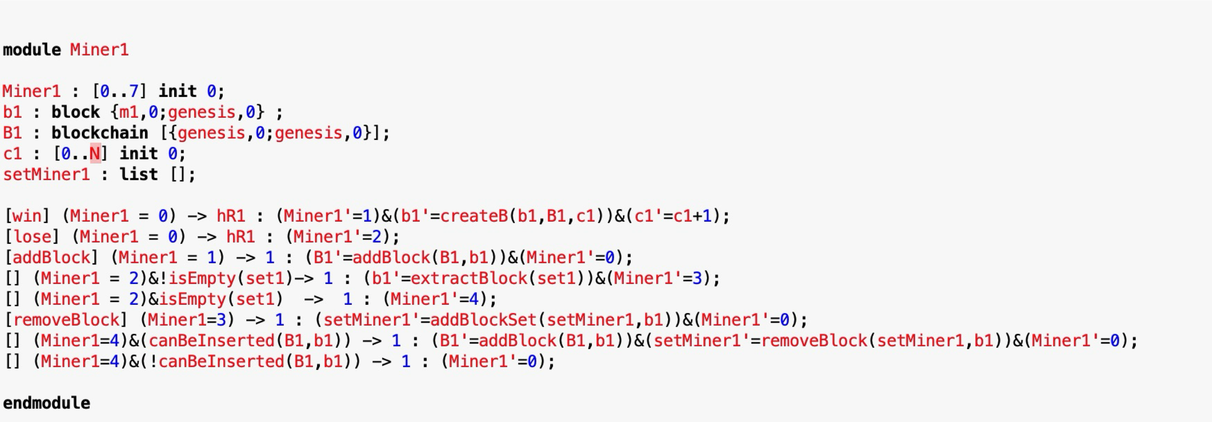
Bitcoin example
Original PRISM Model¹
Choreographic Model
Projected PRISM Model
[1] Stefano Bistarelli, Rocco De Nicola, Letterio Galletta, Cosimo Laneve, Ivan Mercanti, Adele Veschetti: Stochastic modeling and analysis of the bitcoin protocol in the presence of block communication delays. Concurr. Comput. Pract. Exp. 35(16) (2023)

Slide 16
Conclusions Next Steps
We have developed a choreographic calculus
Probabilistic
Models concurrent probabilistic systems
Expressive clarity
Implemented correct projection
Current/Future Work
Extend the language and the theory
Generate Markov Chain directly from the choreographies
Can we directly generate Markov Chains?
Would this improve the performance drastically?

Slide 17
THANK YOU!
Questions?
Adele Veschetti
adele.veschetti@tu-darmstadt.de

